Slide 1
MALARIA DETECTION USING DEEP LEARNING
TEAM MEMBERS :
ARAVIND B S
JEEVA K
SOURAV R

Slide 2
INTRODUCTION :
With regular manual diagnosis of blood smears, it is an intensive manual process requiring proper expertise in classifying and counting the parasitized and uninfected cells. Typically this may not scale well and might cause problems if we do not have the right expertise in specific regions around the world. Some advancements have been made in leveraging state-of-the-art (SOTA) image processing and analysis techniques to extract hand-engineered features and build machine learning based classification models. However these models are not scalable with more data being available for training and given the fact that hand-engineered features take a lot of time.Deep Learning models, or to be more specific, Convolutional Neural Networks (CNNs) have proven to be really effective in a wide variety of computer vision tasks.

Slide 3
PROPOSED SYSTEM :
CNNs help us with automated and scalable feature engineering. Also, plugging in dense layers at the end of our model enables us to perform tasks like image classification. Automated malaria detection using deep learning models like CNNs could be very effective, cheap and scalable especially with the advent of transfer learning and pre-trained models which work quite well even with constraints like less data.
Convolution layers learn spatial hierarchical patterns from the data, which are also translation invariant. Thus they are able to learn different aspects of images. For example, the first convolution layer will learn small and local patterns such as edges and corners, a second convolution layer will learn larger patterns based on the features from the first layers, and so on.

Slide 4
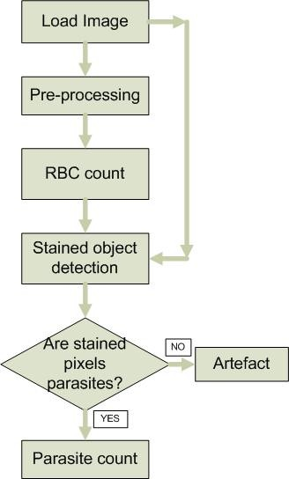
FLOWCHART :

Slide 5
COMPONENTS USED :
PYTHON
HTML
CSS
JavaScript
Tensorflow
Keras

Slide 6
ADVANTAGES :
it robust enough to understand and use novel data, but most data scientists have learned to control the learning to focus on what’s important to them.
it allows us to teach a specific task rather than teaching the system how to learn. We can use different examples to train a particular model or we can use a very simple training set and simply ask it to learn.
it can go and get a new image from its own memory.

Slide 7
SYSTEM REQUIREMENTS :
HARDWARE :
RAM : 1 GB OR ABOVE
STORAGE : 1 GB OR ABOVE
PROCESSOR : MODERATE PROCESSOR
SOFTWARE :
BROWSER(ANY)
SPYDER(ANACONDA IDE)

Slide 8
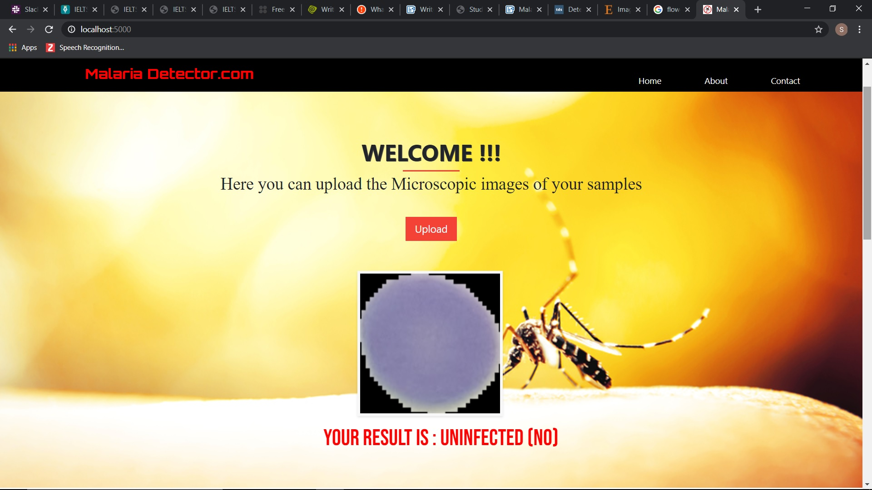
RESULT :

Slide 9
CONCLUSION :
We looked at an interesting real-world medical imaging case study of malaria detection in this article.
Malaria detection by itself is not an easy procedure and the availability of the right personnel across the globe is also a serious concern.
We looked at easy to build open-source techniques leveraging AI which can give us state-of-the-art accuracy in detecting malaria thus enabling AI for social good.

Slide 10


